Slide 3

Stéphane van Gulick
Former 8 year Microsoft MVP (PowerShell)
Trainer
Automatisation
Powershell
Pester
Devops (CI/CD)
Devops Engineer

Slide 4
Vision d’ensemble
Introduction
Historique des objets au sein de Powershell et leur limites
Introduction à la programmation orienté objet
Vocabulaire

Slide 5
La programmation orienté objet
Pourquoi est-ce important ?
Ce n’est pas que un concept technique: C’est une philosophie
Elements conceptionels
Les 4 piliers de l’OOP
Les règles
SOLID

Slide 6
Qu’est-ce un objet dans Powershell ?
TOUT!

Slide 7
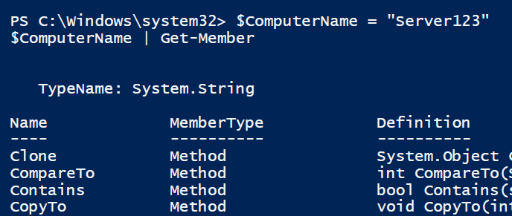
Vous utilisez des “instances” de classes depuis toujours!

Slide 8
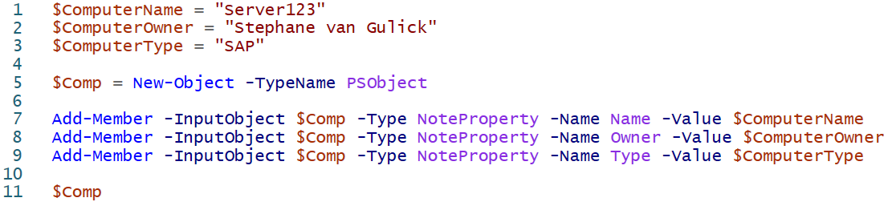
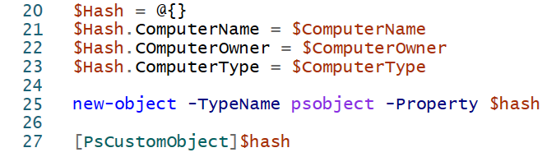
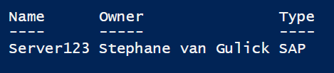
Les objets Jadis: (Creation d’objet avant 5.0)

Slide 9
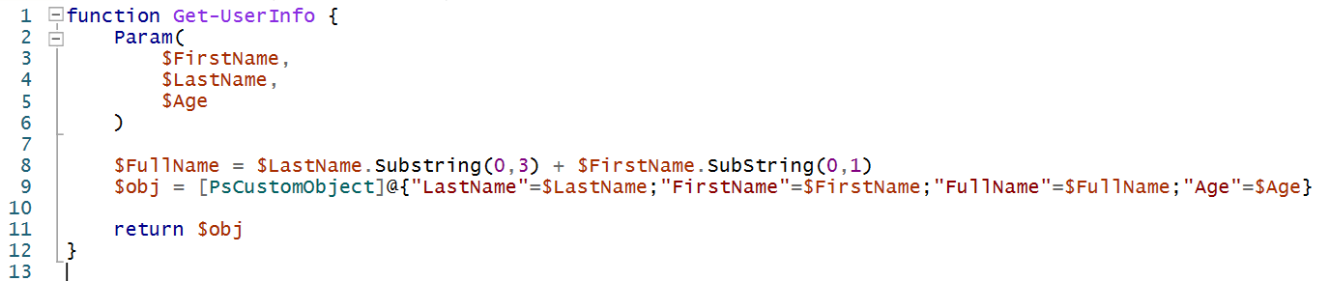
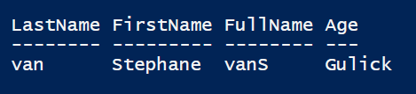
On a déjà les fonctions, non? (1/3)

Slide 10
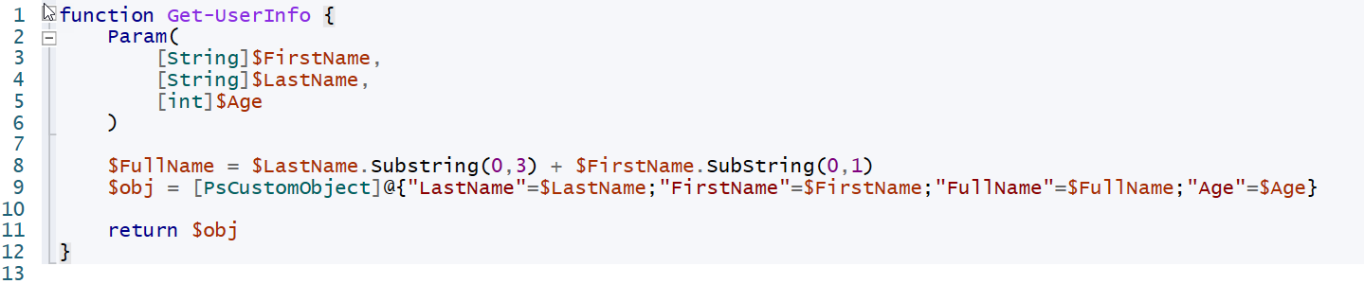
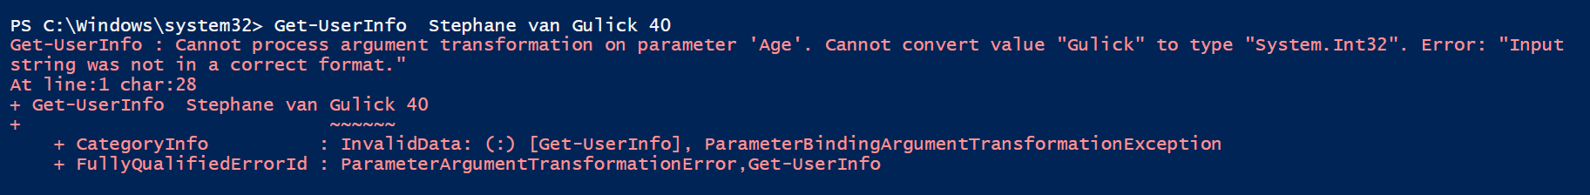
On a déjà les fonctions, non? (2/3)

Slide 11
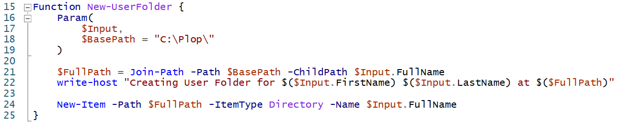
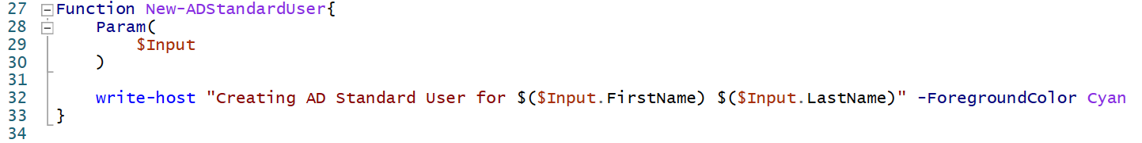
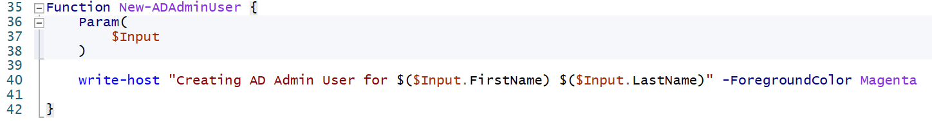
On a déjà les fonctions, non? (3/3)

Slide 12
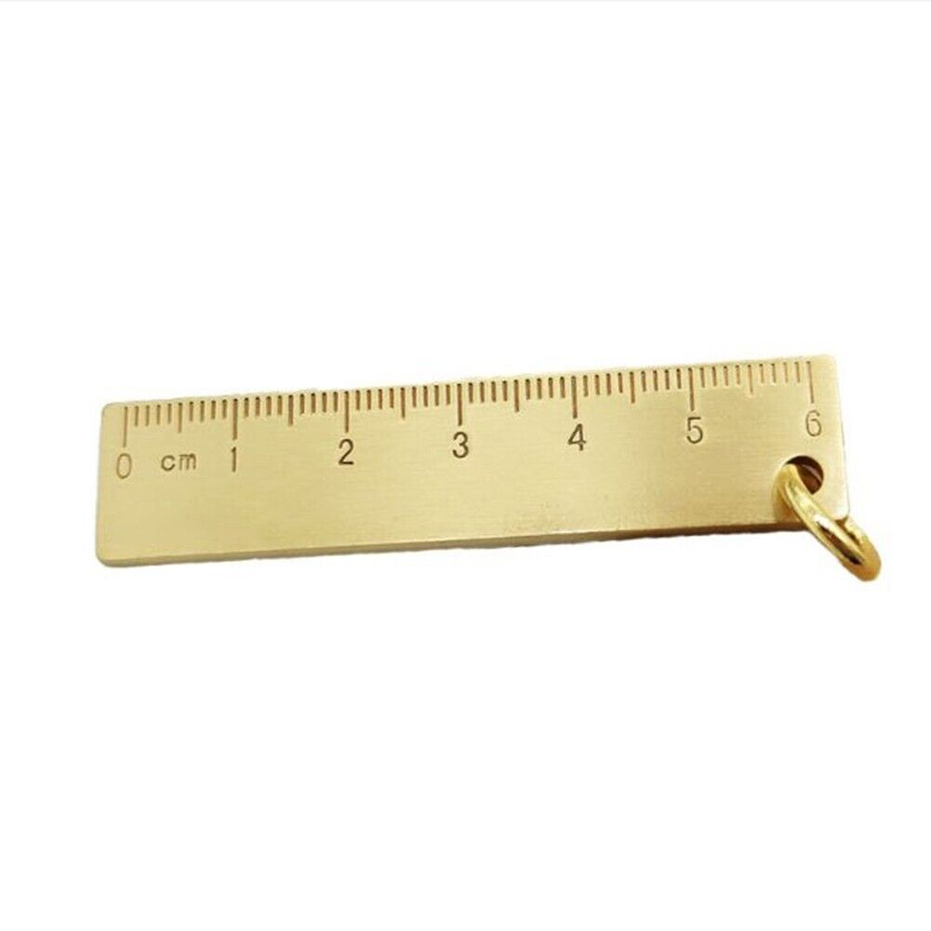
On à déjà les fonctions, non ?
impredictibilité
Flexibilité

Slide 13
Les classes apportent
Predictibilité
Confiance

Slide 14
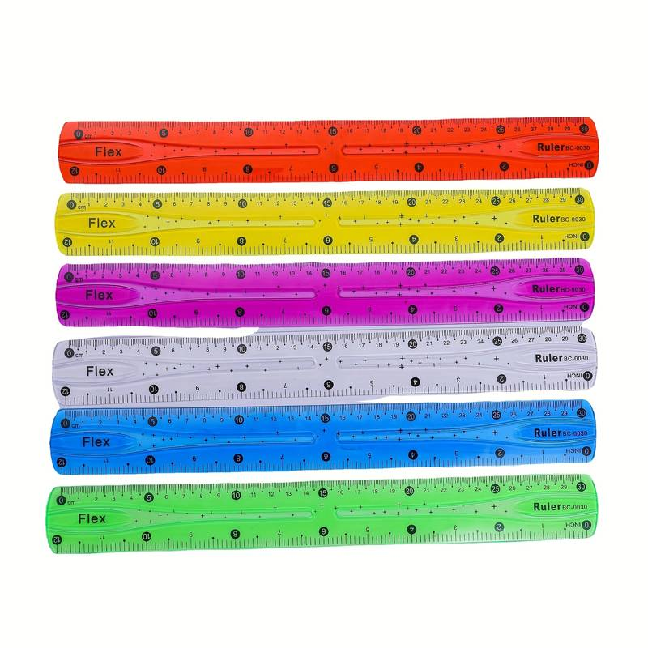

Comment ?

Slide 15
Les classes, c’est quoi ?
Vocabulaire et concepts de base

Slide 16
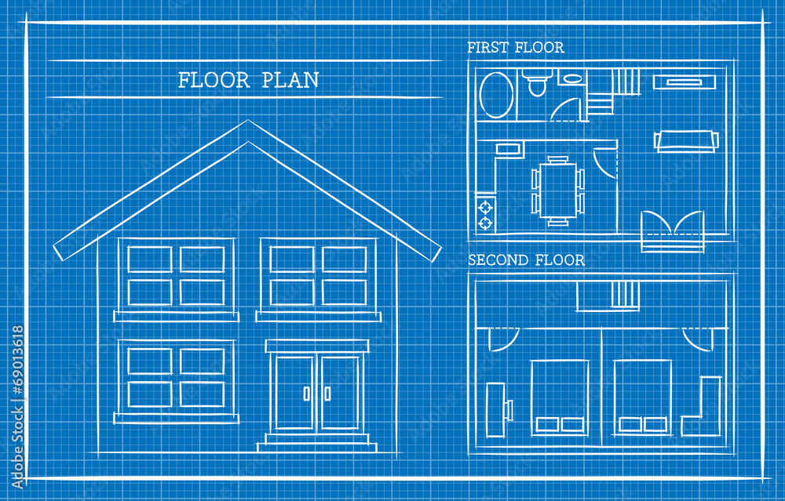

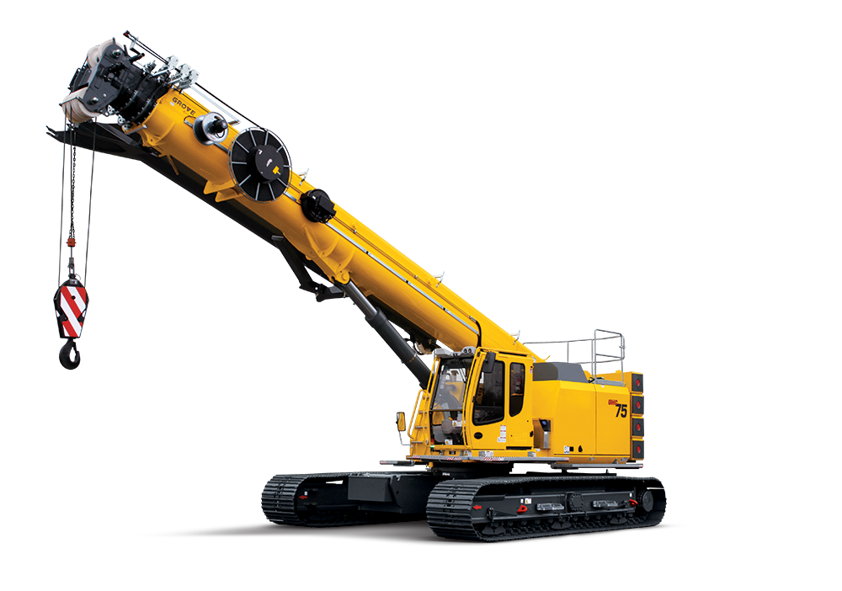
Une classe est un ‘plan’ pour un objet

Slide 17
Une classe c’est quoi ?
Object
$variable =
Instanciation
Donnees
Fonctionalité

Slide 18
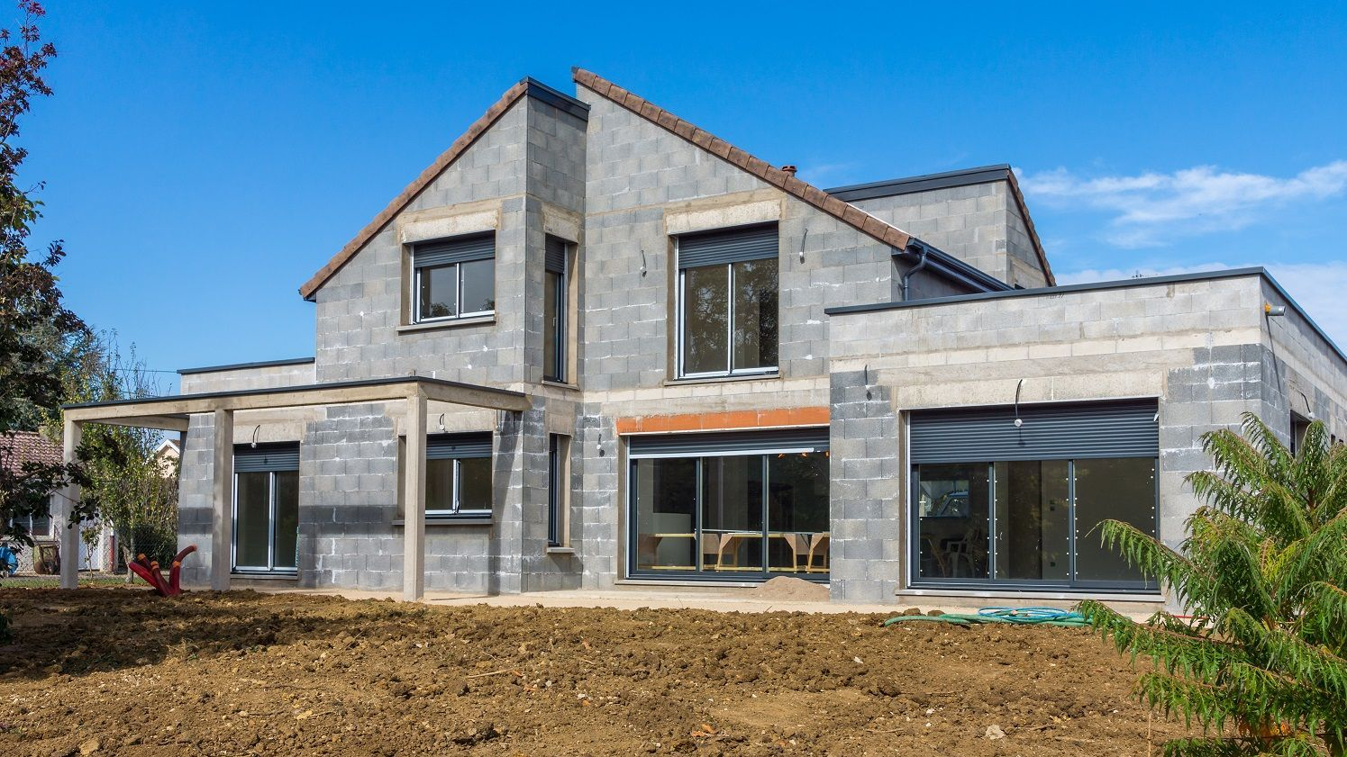
Constructeurs

Slide 19
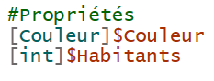
Propriétés
Description / Contextualisation
Hauteur
Couleur
NombreHabitants
JardinArboré

Slide 20
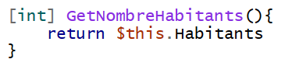
Méthodes
Effectue une action
OuvrirFenetre()
ChaufferPiscine()
SonnerLaSonette()

Slide 21
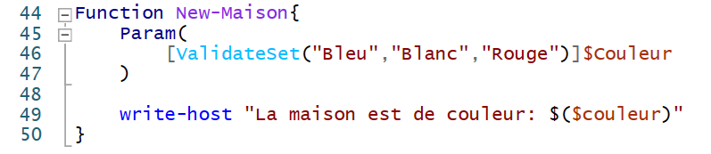
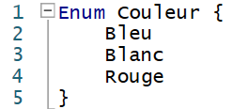
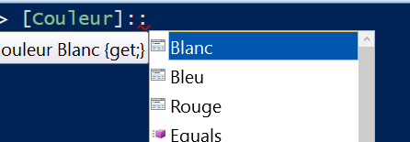
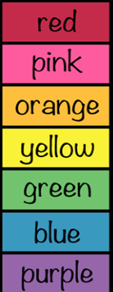
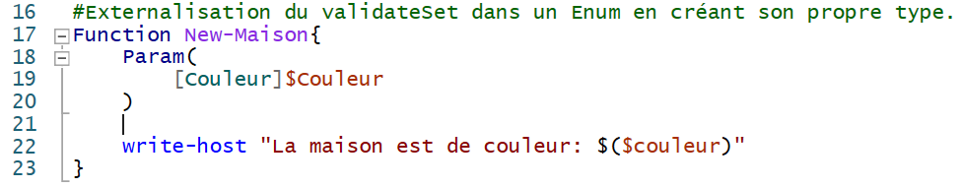
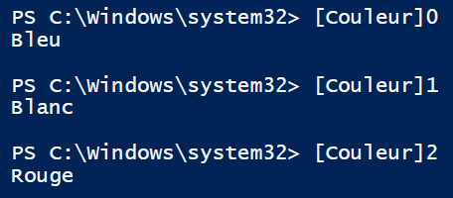
Enums
Notes:
Qui sait ce que c’est un ValidateSet ?

Slide 22
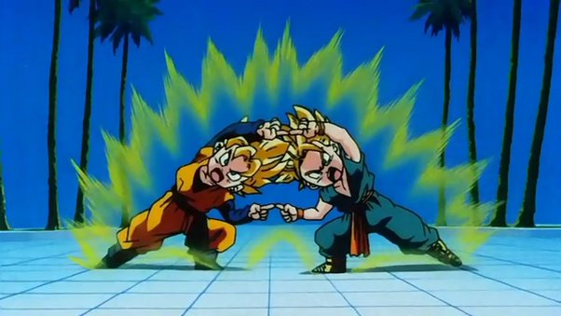
Et maintenant, on combine tout!

Slide 23
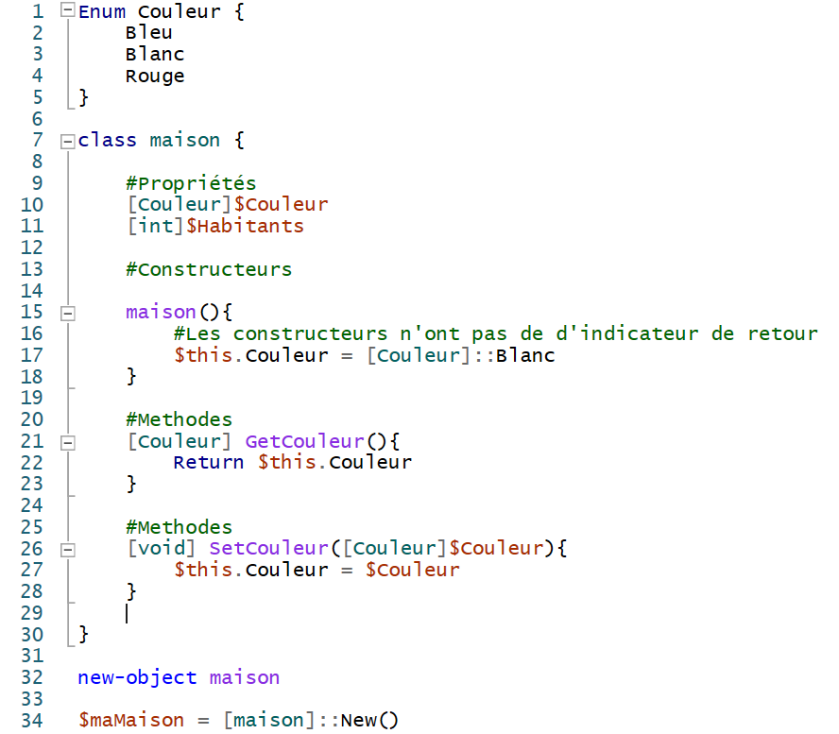
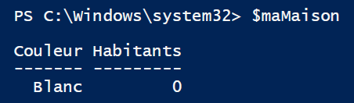
La pratique – Nôtre première classe

Slide 24
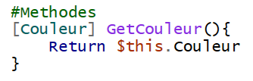
Attends, c’est quoi ‘$this’ ?

Slide 25
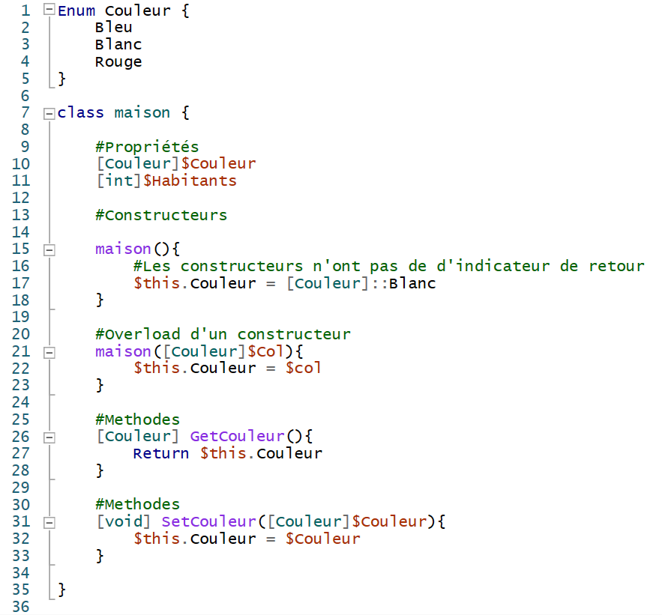
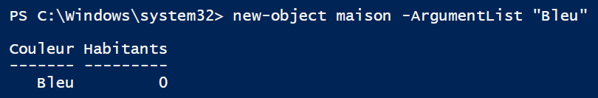
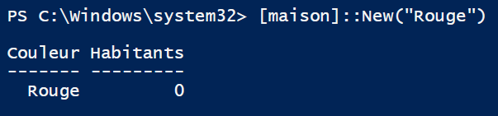
Les overloads

Slide 26
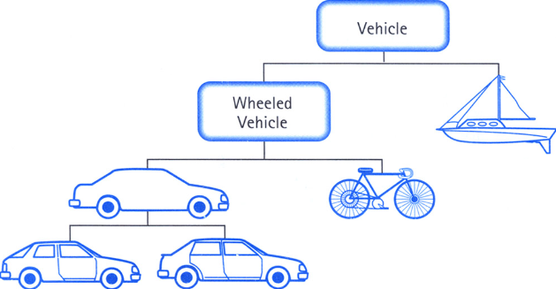
Heritage : Concept

Slide 27
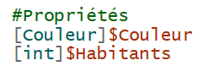

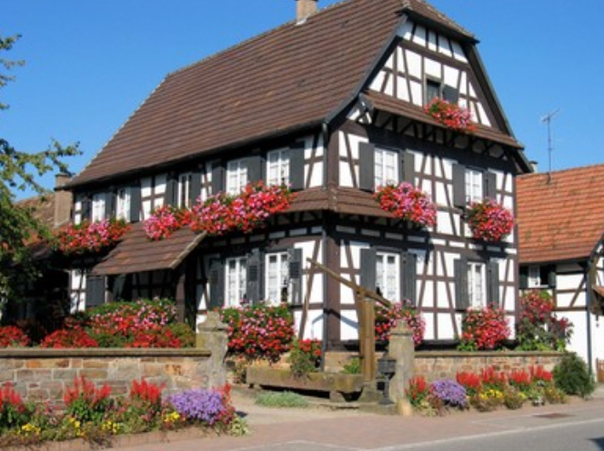
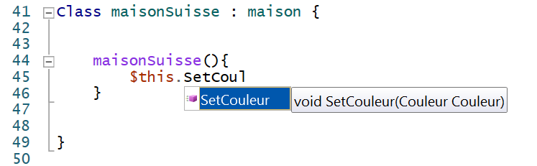
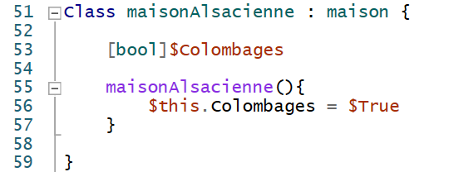
Héritage - Bases
Maison
Maison Suisse
Maison Alsacienne

Slide 28
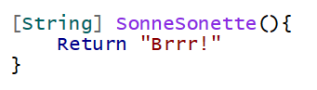
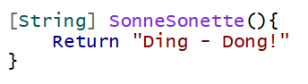
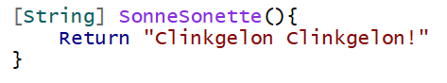
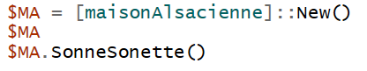
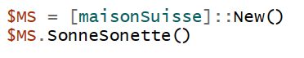
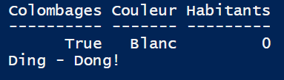
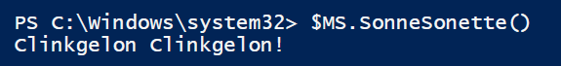
Héritage - Override
Maison
Maison Suisse
Maison Alsacienne

Slide 29
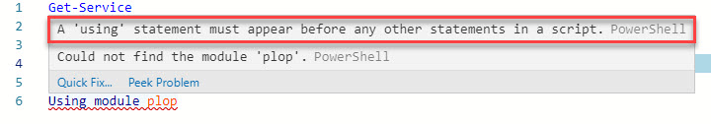
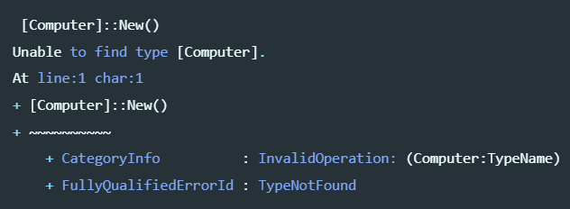
Classes dans les modules :/

Slide 30
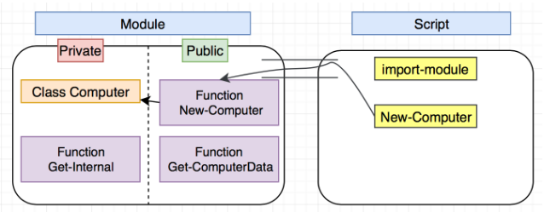
La solution: Hybrid pattern (1/2)

Slide 31
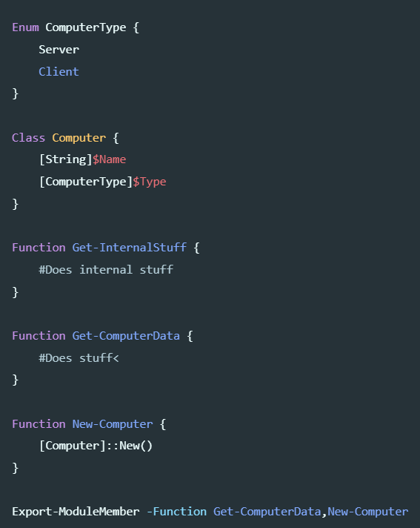
La solution: Hybride pattern (2/2)

Slide 32
Les classes apportent
Predictibilité
Confiance
outils

Slide 33
Ok, pourquoi est-ce important ?
Outils
UML
PsClassUtils (Write-CUClassDiagram)
Creation de tests Pester automatique (Write-CUPesterTests)

Slide 34
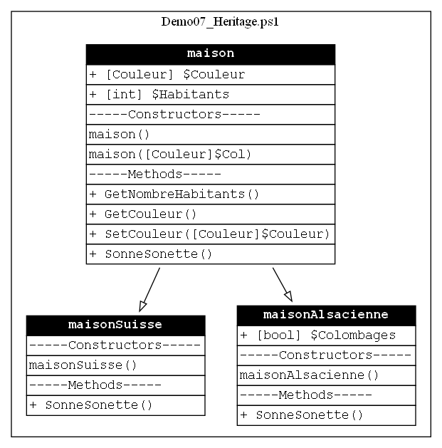
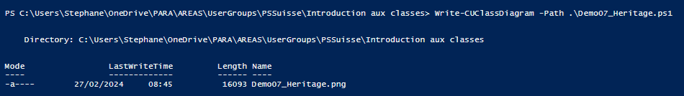
Communication visuelle : uml

Slide 35
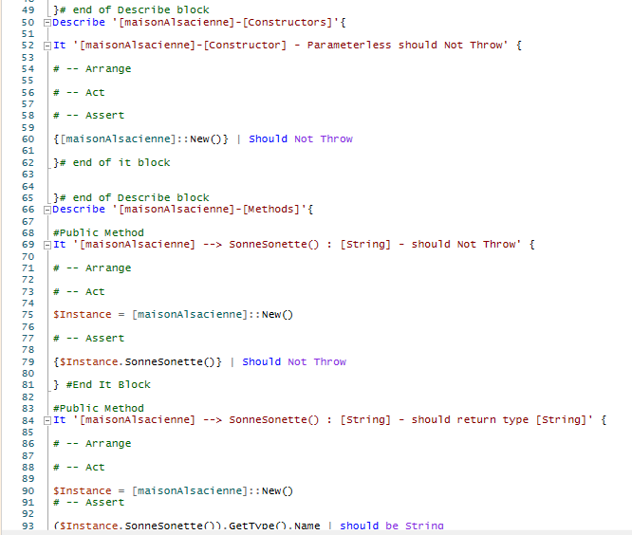
Generation automatique de tests

Slide 36


Le partage de savoir

Slide 37
GOF Patterns (1/2)
Creational[edit]
Main article: Creational pattern
Creational patterns are ones that create objects, rather than having to instantiate objects directly. This gives the program more flexibility in deciding which objects need to be created for a given case.
Abstract factory groups object factories that have a common theme.
Builder constructs complex objects by separating construction and representation.
Factory method creates objects without specifying the exact class to create.
Prototype creates objects by cloning an existing object.
Singleton restricts object creation for a class to only one instance.
Structural[edit]
Structural patterns concern class and object composition. They use inheritance to compose interfaces and define ways to compose objects to obtain new functionality.
Adapter allows classes with incompatible interfaces to work together by wrapping its own interface around that of an already existing class.
Bridge decouples an abstraction from its implementation so that the two can vary independently.
Composite composes zero-or-more similar objects so that they can be manipulated as one object.
Decorator dynamically adds/overrides behavior in an existing method of an object.
Facade provides a simplified interface to a large body of code.
Flyweight reduces the cost of creating and manipulating a large number of similar objects.
Proxy provides a placeholder for another object to control access, reduce cost, and reduce complexity.

Slide 38
GOF Patterns (2/2)
Behavioral[edit]
Most behavioral design patterns are specifically concerned with communication between objects.
Chain of responsibility delegates commands to a chain of processing objects.
Command creates objects that encapsulate actions and parameters.
Interpreter implements a specialized language.
Iterator accesses the elements of an object sequentially without exposing its underlying representation.
Mediator allows loose coupling between classes by being the only class that has detailed knowledge of their methods.
Memento provides the ability to restore an object to its previous state (undo).
Observer is a publish/subscribe pattern, which allows a number of observer objects to see an event.
State allows an object to alter its behavior when its internal state changes.
Strategy allows one of a family of algorithms to be selected on-the-fly at runtime.
Template method defines the skeleton of an algorithm as an abstract class, allowing its subclasses to provide concrete behavior.
Visitor separates an algorithm from an object structure by moving the hierarchy of methods into one object.

Slide 39


Slide 40
Demos
We love Demos!

Slide 41
Q&A
15 minutes

